Slide 1
UNIT 4 Linux OS Forensic Subject - Computer Forensic
Subject Faculty – Ms. Hepi Suthar

Slide 2
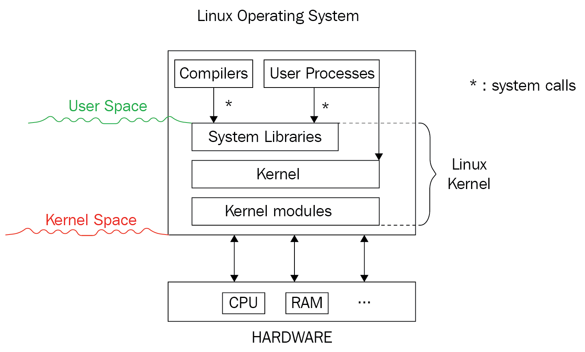
Linux OS Architecture

Slide 3
Linux operating system
An operating system can be described as an interface among the computer hardware and the user of any computer. It is a group of software that handles the resources of the computer hardware and facilitates basic services for computer programs.
An operating system is an essential component of system software within a computer system. The primary aim of an operating system is to provide a platform where a user can run any program conveniently or efficiently.
On the other hand, Linux OS is one of the famous versions of the UNIX OS. It is developed to provide a low-cost or free OS for several personal computer system users. Remarkably, it is a complete OS Including an X Window System, Emacs editor, IP/TCP, GUI (graphical user interface), etc.

Slide 4
Linux operating system history
In 1991, the Linux history started with the starting of a particular project by the Finland student Linus Torvalds for creating a new free OS kernel. The final Linux Kernel was remarked by continuous development throughout the history since then.
Linux was proposed by the Finland student Linus Torvalds in 1991.
HP-UX (Hewlett Packard) 8.0 version was published.
Hewlett Packard 9.0 version was published in 1992.
FreeBSD 1.0 version and NetBSD8 version was released in 1993.
Red Hat Linux was proposed in 1994. Caldera was detected by Ransom love and Bryan Sparks and NetBSD 1.0 version published.

Slide 5
HP-UX 10.0 version and FreeBSD 2.0 version was released in 1995.
K Desktop Environment was established by Matthias Ettrich in 1996.
HP-UX 11.0 version was released in 1997.
The IRIX 6.5 version, i.e., the fifth SGI UNIX generation, Free BSD 3.0 version, and Sun Solaris 7 OS was released in 1998.
The Caldera System agreement with professional services division and SCO server software division was released in 2000.
Linus Torvalds published the Linux version 2.4 source code in 2001.
Microsoft filed the Trademark collection against Lindows.com in 2001.
Lindows name was modified to Linspire in 2004.
The first publication of Ubuntu was published in 2004.
The openSUSE project started a free distribution from the community of Novell In 2005.
Oracle published its Red Hat distribution in 2006.

Slide 6
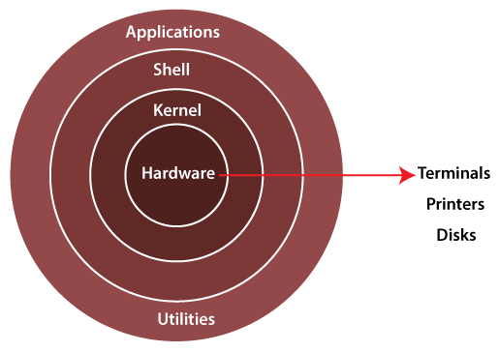
Dell begun laptop distribution with Ubuntu which was pre-installed on it in 2007.
Linux kernel version 3.0 was released in 2011.
Linux-based android of Google insisted 75% of the market share of the Smartphone, based on the number of phones exported in 2013.
Ubuntu insisted on 20000000+ users in 2014.

Slide 7
The Linux operating system's architecture mainly contains some of the components: the Kernel, System Library, Hardware layer, System, and Shell utility.
1. Kernel:- The kernel is one of the core section of an operating system. It is responsible for each of the major actions of the Linux OS. This operating system contains distinct types of modules and cooperates with underlying hardware directly. The kernel facilitates required abstraction for hiding details of low-level hardware or application programs to the system. There are some of the important kernel types which are mentioned below:
Monolithic Kernel
Micro kernels
Exo kernels
Hybrid kernels

Slide 8
2. System Libraries:- These libraries can be specified as some special functions. These are applied for implementing the operating system's functionality and don't need code access rights of the modules of kernel.
3. System Utility Programs:- It is responsible for doing specialized level and individual activities.
4. Hardware layer:- Linux operating system contains a hardware layer that consists of several peripheral devices like CPU, HDD, and RAM.
5. Shell:- It is an interface among the kernel and user. It can afford the services of kernel. It can take commands through the user and runs the functions of the kernel. The shell is available in distinct types of OSes. These operating systems are categorized into two different types, which are the graphical shells and command-line shells.

Slide 9
Linux Operating System Features
Portable: Linux OS can perform different types of hardware and the kernel of Linux supports the installation of any type of hardware environment.
Open source: Linux operating system source code is available freely and for enhancing the capability of the Linux OS, several teams are performing in collaboration.
Multiprogramming: Linux OS can be defined as a multiprogramming system. It means more than one application can be executed at the same time.
Multi-user: Linux OS can also be defined as a multi-user system. It means more than one user can use the resources of the system such as application programs, memory, or RAM at the same time.
Hierarchical file system: Linux OS affords a typical file structure where user files or system files are arranged.

Slide 10
Security: Linux OS facilitates user security systems with the help of various features of authentication such as controlled access to specific files, password protection, or data encryption.
Shell: Linux operating system facilitates a unique interpreter program. This type of program can be applied for executing commands of the operating system. It can be applied to perform various types of tasks such as call application programs and others.

Slide 11
Drawbacks of Linux
Hardware drivers: Most of the users of Linux face an issue while using Linux. Various companies of hardware prefer to build drivers for Mac or Windows due to they contain several users than Linux. Linux has small drivers for peripheral hardware than windows.
Software alternative: Let's take the Photoshop example which is a famous tool for graphic editing. Photoshop exists for Windows; however, it is not available in Linux. Also, there are some other tools for photo editing but the Photoshop tool is more powerful as compare to others. Another example is MS office which is not present for Linux users.
Learning curve: Linux isn't a very user-friendly operating system. Hence, it might be confusing for many beginners. Getting begun with Windows is efficient and easy for many beginners; however, understanding Linux working is complex. We have to understand the command line interface and finding for newer software is a little bit complex as well. When we face any issue in the OS, the searching solution is very problematic. Also, there are various experts for Mac and Windows as compare to Linux.
Games: Several games are developed for Windows but unfortunately not for Linux. Because the platform of Windows is used widely. So, the developers of the games are more interested in windows.

Slide 12
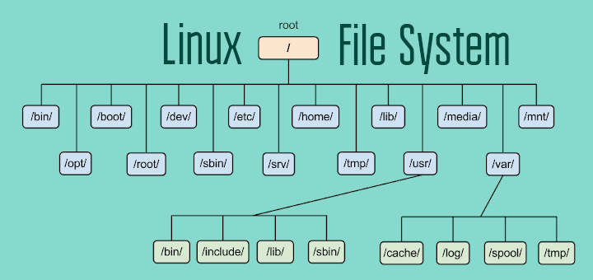
File System & Analysis
https://tldp.org/LDP/intro-linux/html/sect_03_01.html#:~:text=A%20Linux%20system%2C%20just%20like,files%2C%20according%20to%20the%20system.

Slide 13
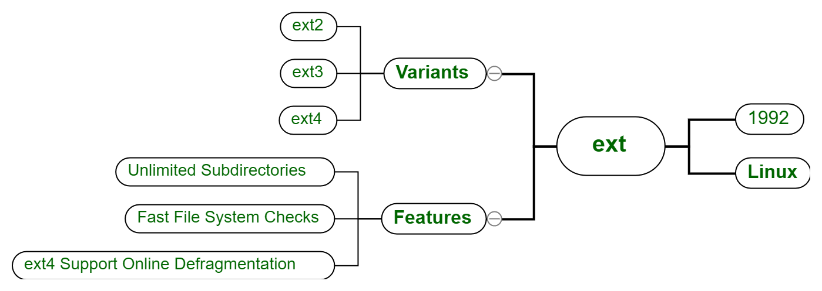
Ext -

Slide 14
The original EXT filesystem (Extended) was written by Rémy Card and released with Linux in 1992 to overcome some size limitations of the Minix filesystem.
The primary structural changes were to the metadata of the filesystem, which was based on the Unix filesystem (UFS), which is also known as the Berkeley Fast File System (FFS).
I found very little published information about the EXT filesystem that can be verified, apparently because it had significant problems and was quickly superseded by the EXT2 filesystem.
https://opensource.com/article/17/5/introduction-ext4-filesystem

Slide 15
Understanding and Analysis of EXT file System
The original EXT filesystem (Extended) was written by Rémy Card and released with Linux in 1992 to overcome some size limitations of the Minix filesystem.
The primary structural changes were to the metadata of the filesystem, which was based on the Unix filesystem (UFS), which is also known as the Berkeley Fast File System (FFS).
I found very little published information about the EXT filesystem that can be verified, apparently because it had significant problems and was quickly superseded by the EXT2 filesystem.
https://opensource.com/article/17/5/introduction-ext4-filesystem

Slide 16
Recreating Ext Partition
If you are restoring an operating system partition, boot your system into Rescue Mode. See the Booting to Rescue Mode section of the System Administrator's Guide.
This step is not required for ordinary data partitions.
Rebuild the partitions you want to restore by using the fdisk or parted utilites.
If the partitions no longer exist, recreate them. The new partitions must be large enough to contain the restored data. It is important to get the start and end numbers right; these are the starting and ending sector numbers of the partitions obtained from the fdisk utility when backing up.
https://access.redhat.com/documentation/en-us/red_hat_enterprise_linux/7/html/storage_administration_guide/extrestore

Slide 17
Analysing Unallocated Partition
Data Recovery.
https://habr.com/en/company/hetmansoftware/blog/552662/

Slide 18
Log Analysis : Understanding various Log

